Slide 1
FYP Interim Presentation
201819
Title: The Truth about Twitter
Student: Max MacDonald
Supervisor: Cindy Liu
Keywords: Data Mining, Machine Learning, Twitter API

Slide 2
Background Research
Online Human-Bot Interactions: Detection, Estimation, and Characterization
Principles of Data Mining
Building Machine Learning Systems with Python

Slide 3
Approaches
Agile & Kanban:
Iterative and incremental
Visualise the flow of work
Limit the work in progress
Enhance the flow

Slide 4
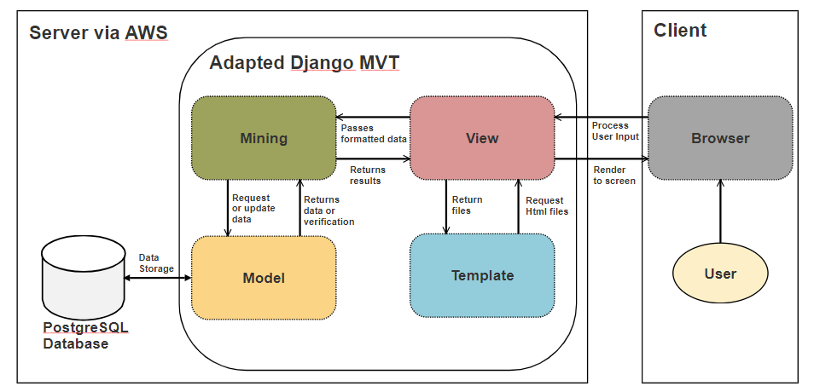
Design
Technical Architecture:

Slide 5
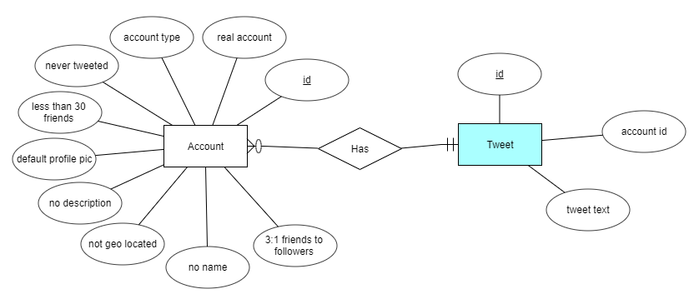
Design
Entity Relationship Diagram:

Slide 6
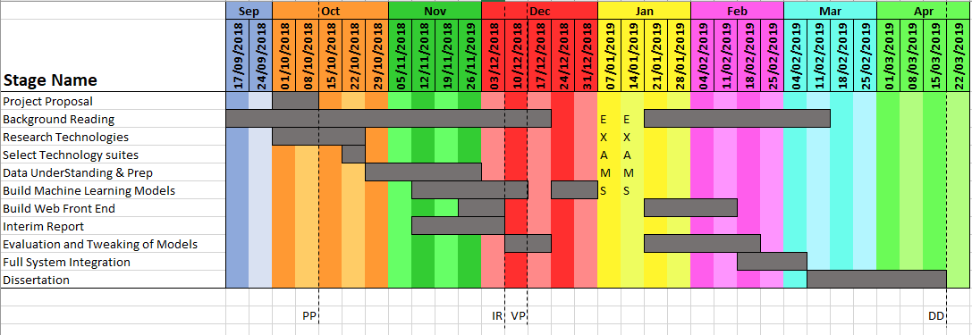
Project Plan
Gantt Chart:

Slide 7
Challenges
Oauth2 authentication
Model Accuracy
Integration and Deployment

Slide 8

Prototype

